Slide 1
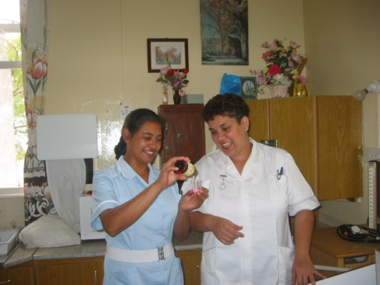
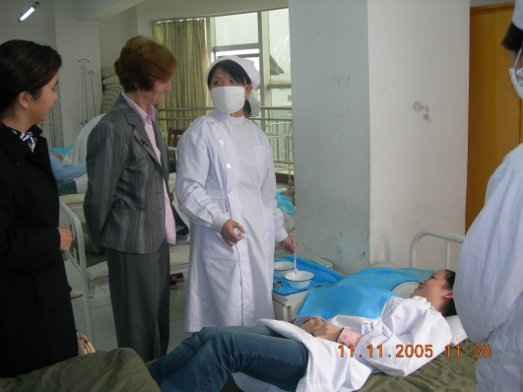
http://globalresearchnurses.tghn.org/ PART OF GLOBAL HEALTH NETWORK

Slide 2
WHAT IS THE GLOBAL RESEARCH NURSES’ NETWORK?
A NEW NETWORK FOR ALL NURSES WORKING IN RESEARCH
A NEW RESOURCE TO HELP MEET NEEDS OF RESEARCH NURSES

Slide 3
WHAT IS THE GLOBAL RESEARCH NURSES’ NETWORK?
WHAT YOU TELL US WHAT YOU WANT ...

Slide 4
WHAT IS THE GLOBAL RESEARCH NURSES’ NETWORK?
A NETWORK FOR NURSES WHO WANT TO LEARN, DEVELOP, CONTRIBUTE
A FORUM WITH A CLEAR FOCUS AND SHARED VALUES
A NETWORK WHERE PARTICIPANTS HAVE A VOICE AND ARE VALUED

Slide 5
WHO IS IT FOR?
NURSES WORKING IN CLINICAL RESEARCH
NURSES RESEARCHING NURSING
NURSES USING RESEARCH IN THEIR PRACTICE
= ALL NURSES!

Slide 6
WHERE IS IT?
On the Global Health Network
http://globalresearchnurses.tghn.org/
http://globalresearchnurses.tghn.org/

Slide 7
A NURSES’ NETWORK IS NEEDED BECAUSE ..
Nurses and midwives are the largest group of health care workers … and essential to the delivery of care.

Slide 8
Nurses and Midwives: A force for health; WHO, 2009
Nurses and midwives are well-recognized and essential to providing good health care.
Nursing and midwifery is a vital component of the health workforce and are acknowledged professionals who contribute significantly to the achievements of the MDGs.
http://www.euro.who.int/__data/assets/pdf_file/0019/114157/E93980.pdf

Slide 9
nurses greatly outnumber doctors …
Carol Baldwin, 2010, Arizona State University College of Nursing and Health Innovation
nurse/patient ratio of 36.8 nurses per 100,000 population in Malawi (WHO, 2011)
 | Malawi | South Africa | Zambia
Nurses: Doctors | 25:1 | 6:1 | 7:1

Slide 10
CORE ROLES OF NURSES
CARER
MANAGER
COMMUNICATOR
EDUCATOR
RESEARCHER

Slide 11
A NURSES’ NETWORK IS NEEDED BECAUSE ..
Nurses and midwives share values.

Slide 12
Values of professional nurses
MALAWI –
University of Mzuzu
Altruism
Equality
Esthetics
Freedom
Human Dignity
Justice
Truth
Research Activities
UK – Nurses’ and Midwives’ Council
We are accountable
We are fair
We are professional
We are progressive
We are inclusive

Slide 13
‘act always in the patient’s best interest’ … UK, Nurses’ and Midwives’ Council, UK.
‘give full attention to the client/patient when providing care’ …
Mzuzu University, Malawi.

Slide 14
Professional nurses seek to do what is best for patients and clients …
therefore need EVIDENCE FOR PRACTICE

Slide 15
PATIENT’S BEST INTEREST …
high quality care and treatment for patients of today and tomorrow –
Responsibility to ensure standards and interventions are evidence based
.. need research to describe what is to be done

Slide 16
Nurses are increasingly knowledgeable about the research process
Increasingly involved in research
Increasingly need support to develop research skills
= THE GLOBAL RESEARCH NURSES’ NETWORK

Slide 17
HOW CAN THE NETWORK HELP?
recognise the problems faced by nurses in research ...
work together to find ways to overcome problems ...

Slide 18
THE GLOBAL RESEARCH NURSES NETWORK WILL
HELP NURSES TO FACE THE CHALLENGES.
IT CAN
PROVIDE SUPPORT
SHARE VALUES
BUILD ESTEEM
PROMOTE PROFESSIONAL IDENTITY

Slide 19
CHALLENGES FOR NURSES AND MIDWIVES:
POOR PAY
POOR RESOURCES
HEAVY WORKLOAD – SHORTAGE OF CARE WORKERS
LACK OF TRAINING/ UPDATES
LACK OF PROMOTION

Slide 20
WHAT WILL THE NETWORK DO?
do what you say you want it to do ....
find ways to work together to solve problems
PLEASE KEEP IN TOUCH... AND MAKE IT WORK

Slide 21
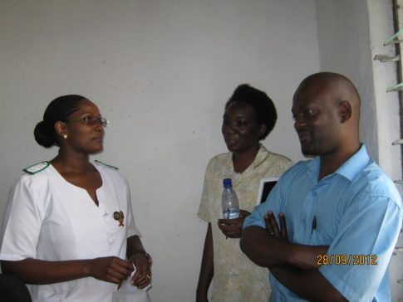
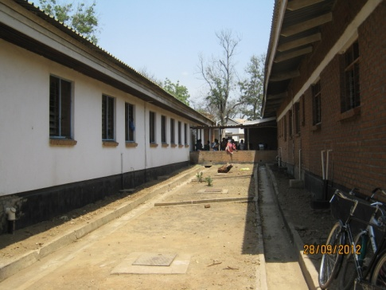
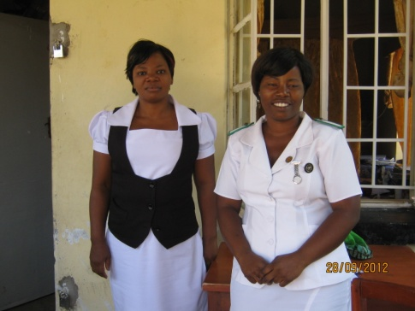
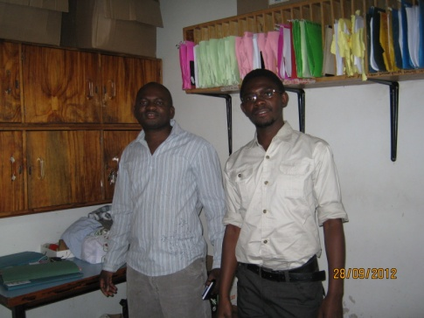
WHAT IT IS AND HOW IT IS USED DEPENDS ON YOU ..

Slide 22
n
h
c
M
r
a
e
e
t
s
h
o
e
o
R
d
D
i
s
s
e
C
e
i
c
o
n
l
e
m
i
V
i
c
m
v
S
u
e
y
n
e
r
Global Health Network for
Research Nurses
i
r
h
o
t
i
t
y
t
a
n
r
B
g
o
a
g
b
s
n
a
e
S
i
L
d
t
t
a
r
y
M
a
e
g
t
o
u
r
l
l
e
o
t
C
i
i
m
d
g
i
e
s
d
c
y
i
i
p
p
E
l
i
n
a
r
y

