Slide 1
Toolkit for research and development of paediatric antiretroviral drugs and formulations

Slide 2
Module 5: Acceptability

Slide 3
Off label or off license paediatric therapy

Slide 4
US & EU legislations and guidance

Slide 5
Acceptability, adherence, effectiveness and safety

Slide 6
Defining acceptability

Slide 7
Acceptability, appropriateness, adherence

Slide 8
Liquid and solid oral dosage forms

Slide 9
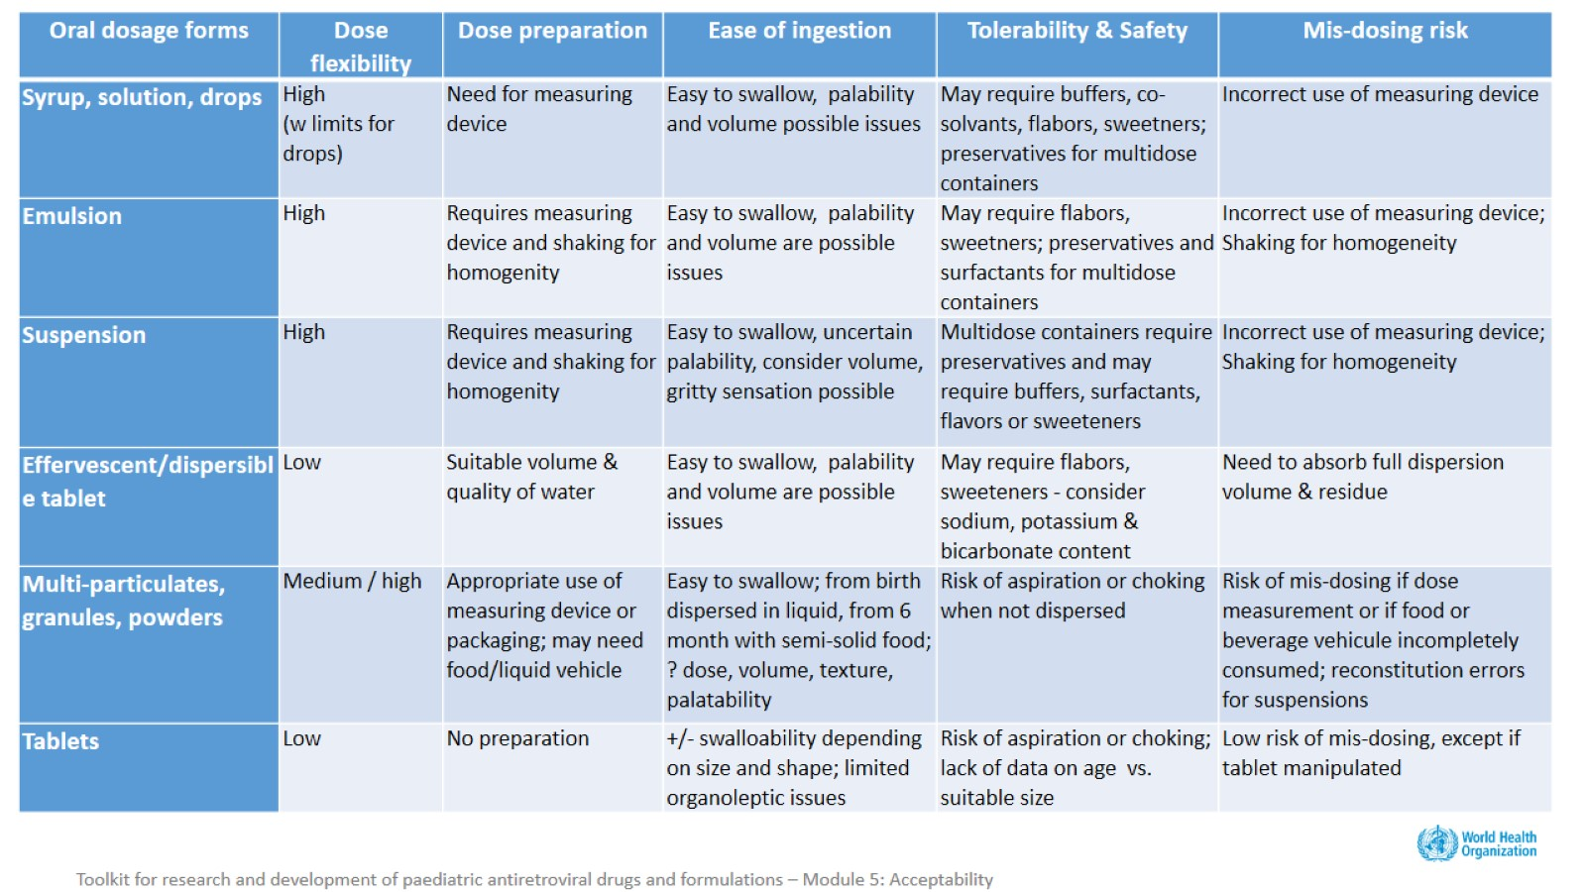

Slide 10
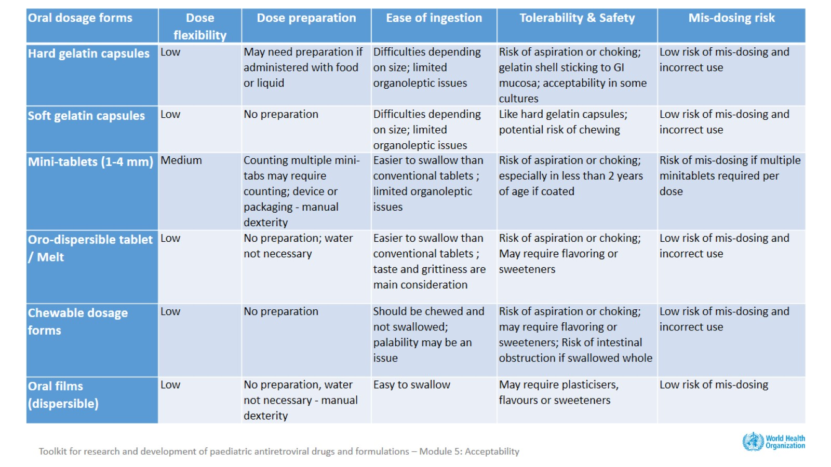

Slide 11
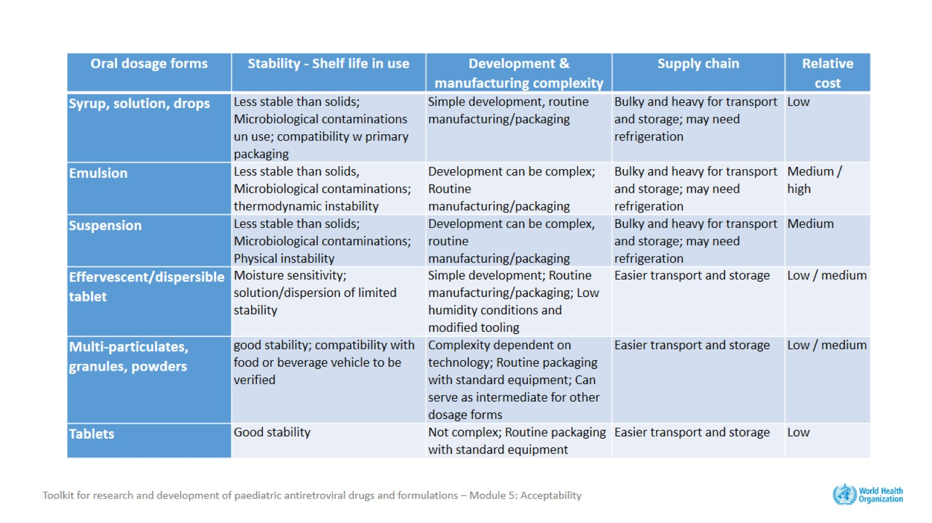

Slide 12
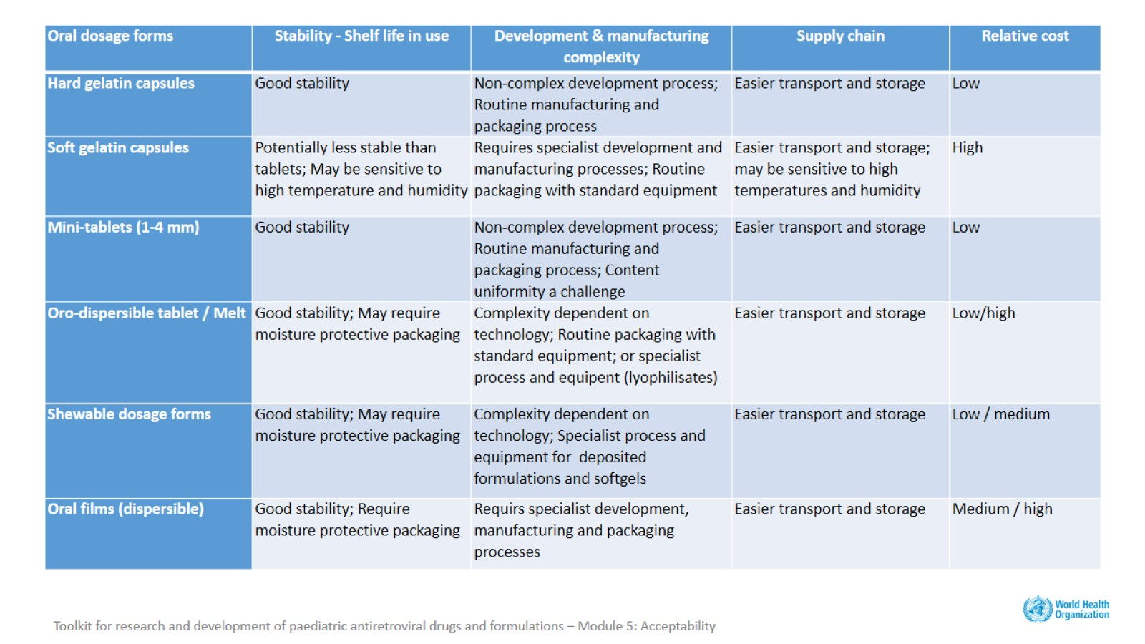

Slide 13
Formulations should have flexible dosage increments and minimal excipients, and should be palatable, safe and easy to administer, and light, humidity and heat stable

Slide 15
Acceptability is a property of the medicinal product

Slide 16
It is also defined by the end user

Slide 17
Acceptability, adherence, clinical appropriateness

Slide 18
From acceptability to adherence

Slide 19
Challenges

Slide 20
Little guidance, no standardisation

Slide 21
What aspects of acceptability should be considered and measured?

Slide 22
With which tools should acceptability be measured?

Slide 23
Who can provide information on medicine acceptability?

Slide 24
Key considerations (1)

Slide 25
Key considerations (2)

Slide 26
Acknowledgements

